Slide 1
Unit 2
What time do you go to school?

Slide 2


Riddle
谜语
It has no feet（脚）,
but he can walk （走路）with his hands（手）.
He has no mouth（嘴）,
but he can talk to（对……说） you.
It calls Tick, Tick.
And Tick every day.
What is it?
It’s a clock.

Slide 3
Do you know how to ask the time?
What time is it?
=What is the time?
Can you read the time in English?

Slide 4

What time is it?
=What’s the time ?
It's nine (o'clock).

Slide 5
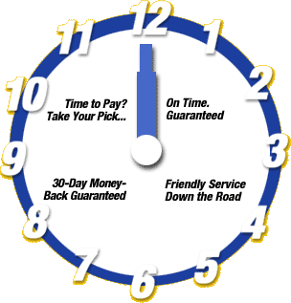
What time is it?
=What’s the time?
It's twelve (o'clock).

Slide 6
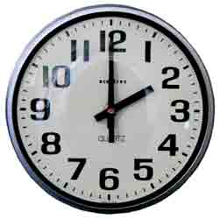
What time is it?
=What’s the time ?
It's two (o'clock).

Slide 7
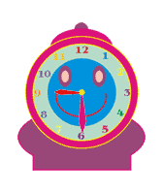
What time is it?
It’s nine thirty.

Slide 8

What time is it?
It’s ten ten.

Slide 9


What time is it?
It’s ten five .
What time is it?
It’s ten ten .

Slide 10
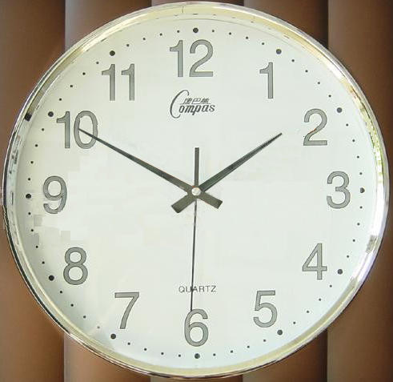
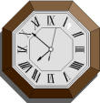
What time is it?
It's one fifty.
What time is it?
It's seven fifty-two.

Slide 11
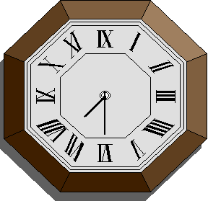
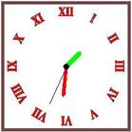
What time is it?
It’s seven thirty .
What time is it?
It’s one thirty .

Slide 12
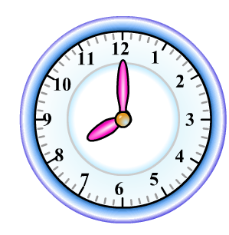
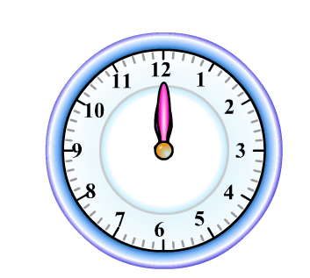
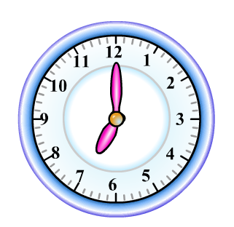
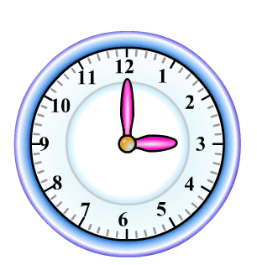
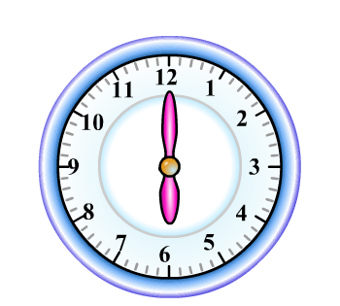
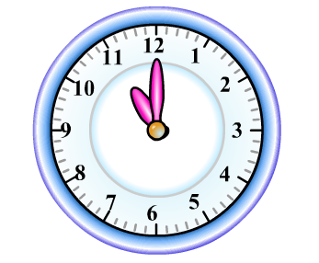
What time is it?

Slide 13
观察与思考：怎样用英语表达时间？
1.整点：
2.整点+分钟：
顺读法
点钟数 +o’clock 如9:00 nine o’clock
点钟数+分钟数 如 10：13 ten thirteen
3.问几点了所用的句子; 如何回答：
What time is it ? / What's the time ?
It's + 时间

Slide 14
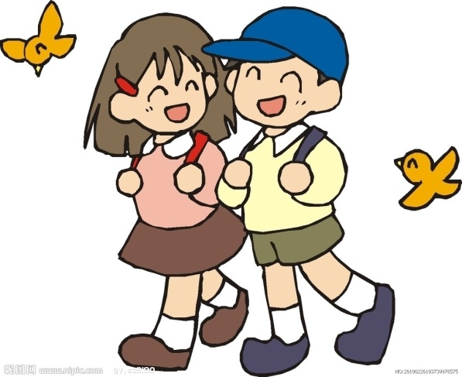
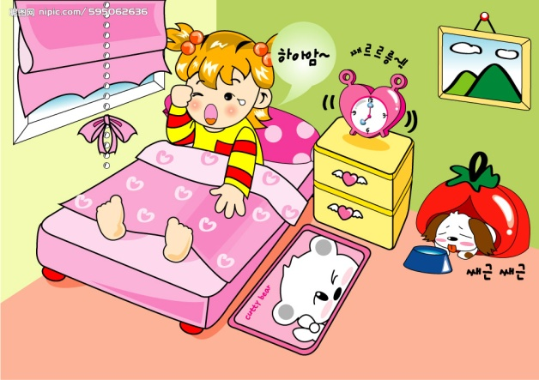
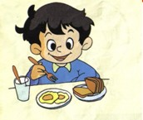
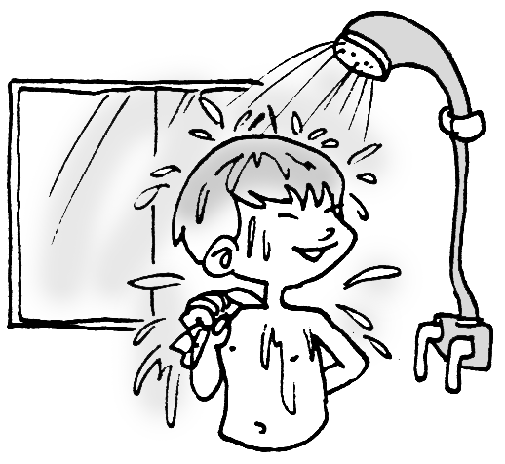
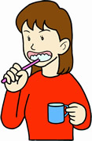
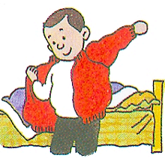
Do you know?
get up
get dressed
go to school
brush teeth
eat breakfast
take a shower

Slide 15

Memory challenge!
快速说出短语

Slide 17
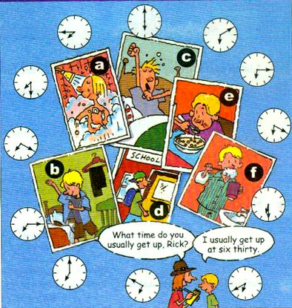
1a Match the activities with the picture.
get up ____
go to school ___
get dressed __
brush teeth __
eat breakfast __
6. take a shower ___
c
d
b
f
e
a

Slide 18

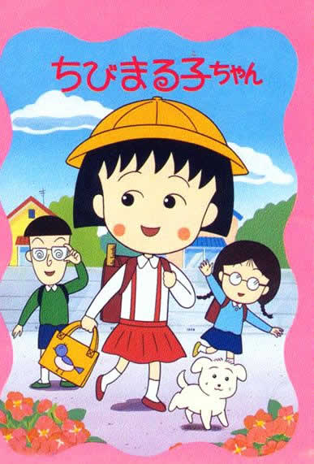
usually
/ju:ʒʊəlɪ/
通常
What time do you go to school?
usually
usually
I go to school at seven fifteen.

Slide 19
1b Listen and match the times with the actions.

Slide 20
Interview Rick.
get up
brush teeth
take a shower
eat breakfast
get dressed
go to school
6:30
6:40
6:40
7:00
7:20
7:30

Slide 21



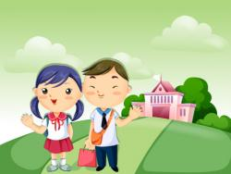
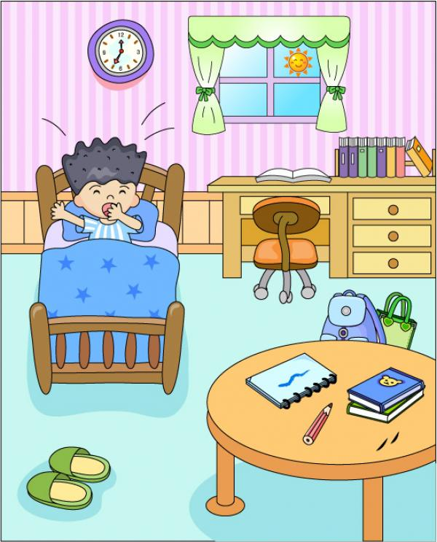
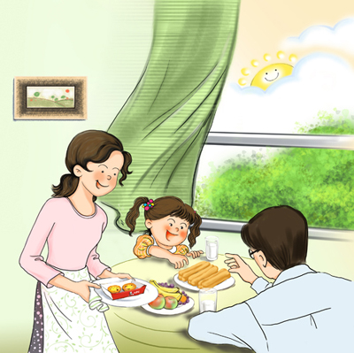
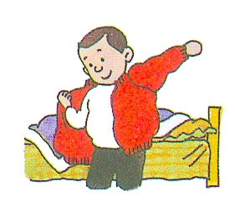
A: What time do you usually…?
B: I usually ….at…
6:40
7:30
6:30
brush teeth
go to school
get up
6:40
7:00
7:20
eat breakfast
take a shower
get dressed

Slide 22
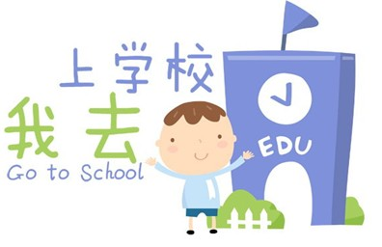
A: What time does he/she usually…?
B: He/She usually ….at…
6:10
8:00
6:00
brush(es )teeth
go(es) to school
get(s) up
6:20
7:15
7:30
take(s) a shower
eat(s) breakfast
get(s) dressed

Slide 23
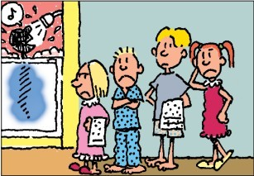
2a Listen to the conversation and complete the sentences.
Jim has ____ brothers and ____ sisters. Jim’s family has ________ shower.
two
two
one

Slide 24
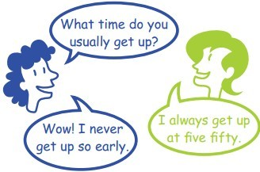
2b Listen again. Complete the shower schedule for Jim’s family.
Name | Bob | Mary | Jack | Jim | Anna
Time | 5:30
5:50
6:15
6:30
6:45

Slide 25

Your time schedule
Activities | Time
get up
take a shower
get dressed
brush teeth
eat breakfast
go to school
6:00
6:15
6:30
6:15
6:50
7:30

Slide 26

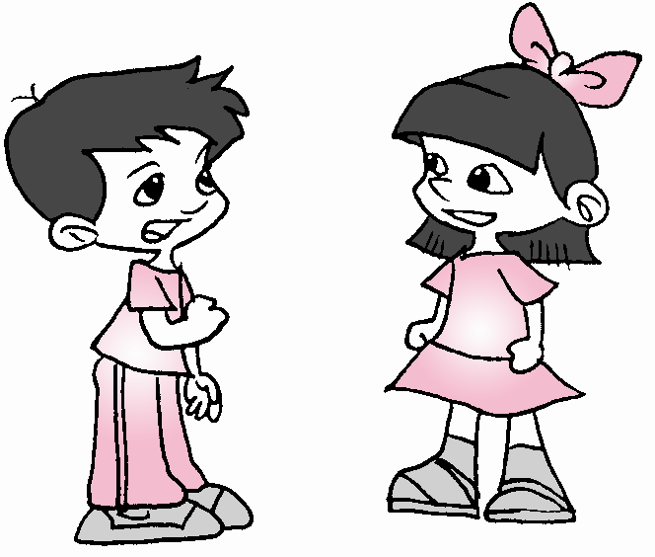
2c Now talk about yourself according to your time schedule.
What time do you usually get up?
I usually get up at five fifty.
从未
早
Wow! I never get up so early.

Slide 27
A:What time do you usually ...?
B:I usually ... at...
Make a survey
get up
brush teeth
eat breakfast
go to school
take a shower
Activity
I
He
She
Report :
I get up at…I eat breakfast at …
My friend xxx gets up at …. He eats breakfast at…. He goes to school at…
xxx gets up at… She brushes teeth at…

Slide 28
Proverbs:
Time is money.
一寸光阴，一寸金。
Time is life.
时间就是生命。
Time flies.
时光如梭。
Time and tide wait for no man.
时不我待！

Slide 29
HOMEWORK
1. Make 2 conversations according to 2c.
-What time do you usually ...?
-I usually ... at ...
2. Recite the new words from "up向上" to "fifty五十"

